Slide 1
Naive Bayes (Classification algo)

Slide 2
Naive Bayes
The Naive Bayes Algorithm is a Machine learning algorithm for classification problems. It is primarily used for text classification, which involves high-dimensional training data sets. A few examples are spam filtration, sentimental analysis and classifying news articles.

Slide 3
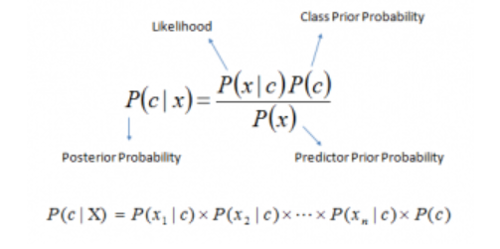
Bayes Theorem
P(c|x) is the posterior probability of class (c, target) given predictor (x, attributes).
P(c) is the prior probability of class.
P(x|c) is the likelihood which is the probability of predictor given class.
P(x) is the prior probability of predictor.

Slide 4
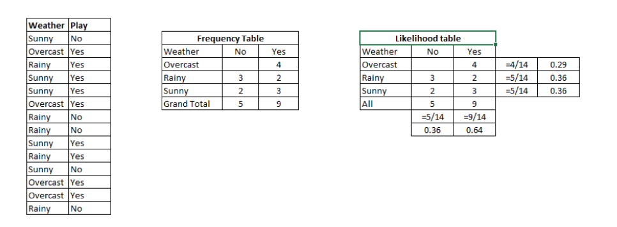
Working of Naive Bayes
Step 1: Convert the data set into a frequency table
Step 2: Create Likelihood table by finding the probabilities like Overcast probability = 0.29 and probability of playing is 0.64.
Step 3: Now, use Naive Bayesian equation to calculate the posterior probability for each class. The class with the highest posterior probability is the outcome of prediction.

Slide 5
Example of Naive Bayes!
Problem: Players will play if weather is sunny. Is this statement is correct?
We can solve it using above discussed method of posterior probability.
P(Yes | Sunny) = P( Sunny | Yes) * P(Yes) / P (Sunny)
Here we have P (Sunny |Yes) = 3/9 = 0.33, P(Sunny) = 5/14 = 0.36, P( Yes)= 9/14 = 0.64
Now, P (Yes | Sunny) = 0.33 * 0.64 / 0.36 = 0.60 (0.6 is closer to 1, hence the class of the above mentioned situation will be “Yes” i:e the player would play)

Slide 6
Assumption
The fundamental Naive Bayes assumption is that each feature makes an:
independent
equal
contribution to the outcome.

Slide 7
Types of Naive Bayes

Slide 8
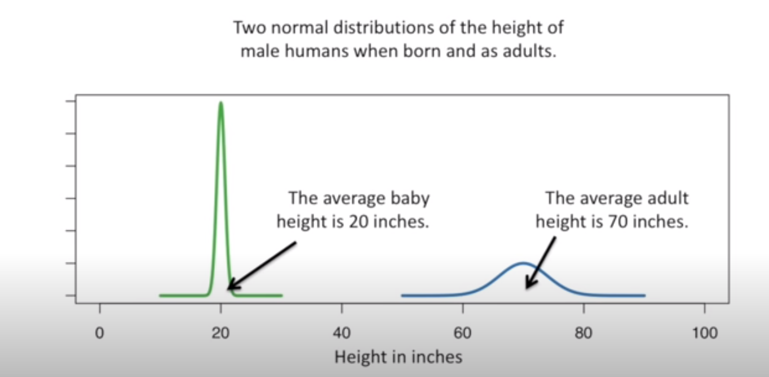
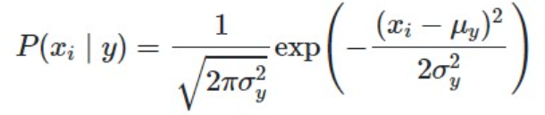
Gaussian NB(uses Gaussian Distribution)
When working with continuous data, an assumption often taken is that the continuous values associated with each class are distributed according to a normal (or Gaussian) distribution.
The likelihood of the features is assumed to be-

Slide 9
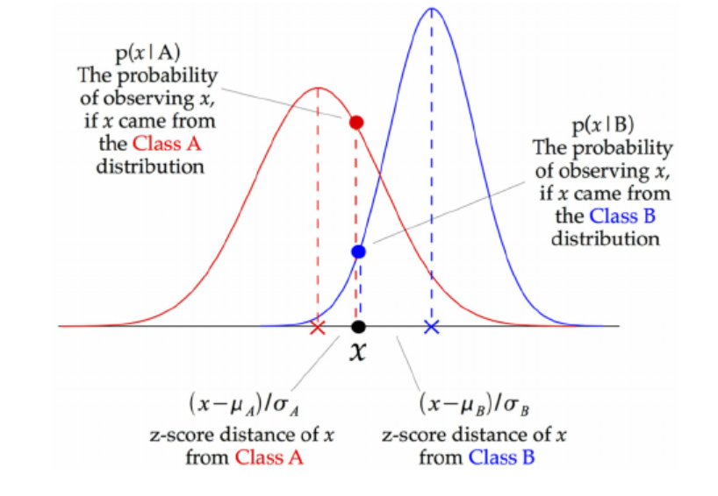
Gaussian Distribution Explanation

Slide 10
Multinomial Naive Bayes
Feature vectors represent the frequencies with which certain events have been generated by a multinomial distribution. This is the event model typically used for document classification.

Slide 11
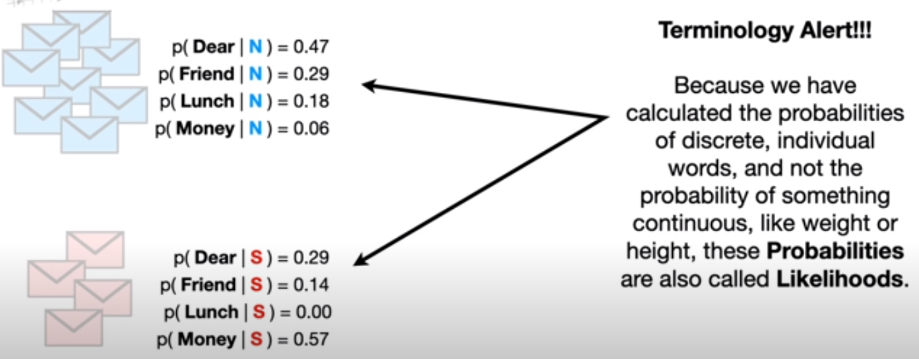
Eg: Multinomial Naive Bayes

Slide 12
Bernoulli Naive Bayes
In the multivariate Bernoulli event model, features are independent booleans (binary variables) describing inputs. Like the multinomial model, this model is popular for document classification tasks, where binary term occurrence(i.e. a word occurs in a document or not) features are used rather than term frequencies(i.e. frequency of a word in the document).

